Slide 1
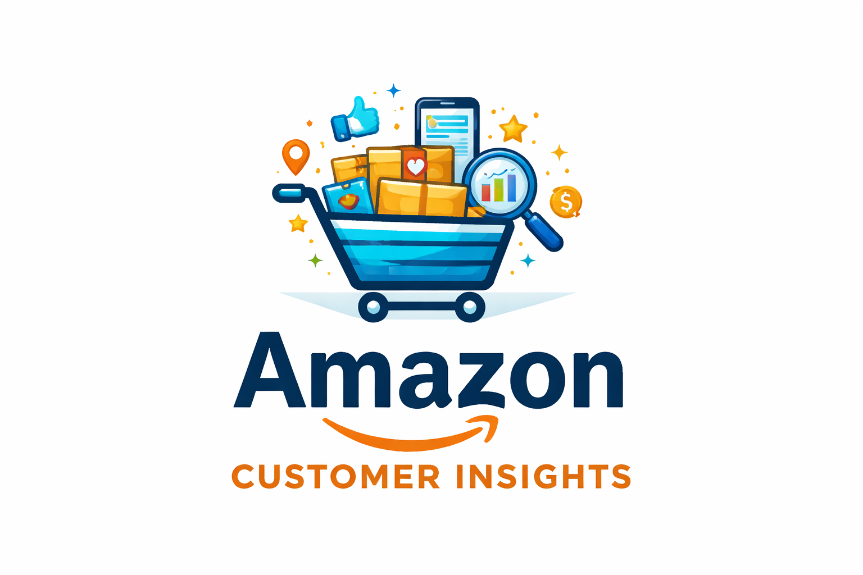
Amazon Customer Purchase Behaviour
Course : Exploratory Data Analysis Using Power BI
By : L. Mahalakshmi
Project Guide : Priya Shanmugam
Batch Code : DA644S64

Slide 2

Problem Statement :
The goal of this project is to analyze customer purchasing behavior on Amazon .
The focus is on understanding revenue patterns, customer preferences, and promotion effectiveness.
Special attention is given to non-Prime customers to understand their buying behavior
The insights can help improve marketing strategies and increase sales.

Slide 3
Objectives
Analyze customer purchase behavior to understand the difference between Prime and Non-Prime customers.
Identify high-performing categories, subcategories, and brands that generate the most revenue from delivered orders.
Evaluate the impact of promotions and seasonal trends on customer purchases and revenue.
Identify active Non-Prime customers with high purchase activity who can be targeted for Prime membership conversion.
Provide data-driven recommendations to encourage Non-Prime customers to upgrade to Prime and increase overall revenue.

Slide 4
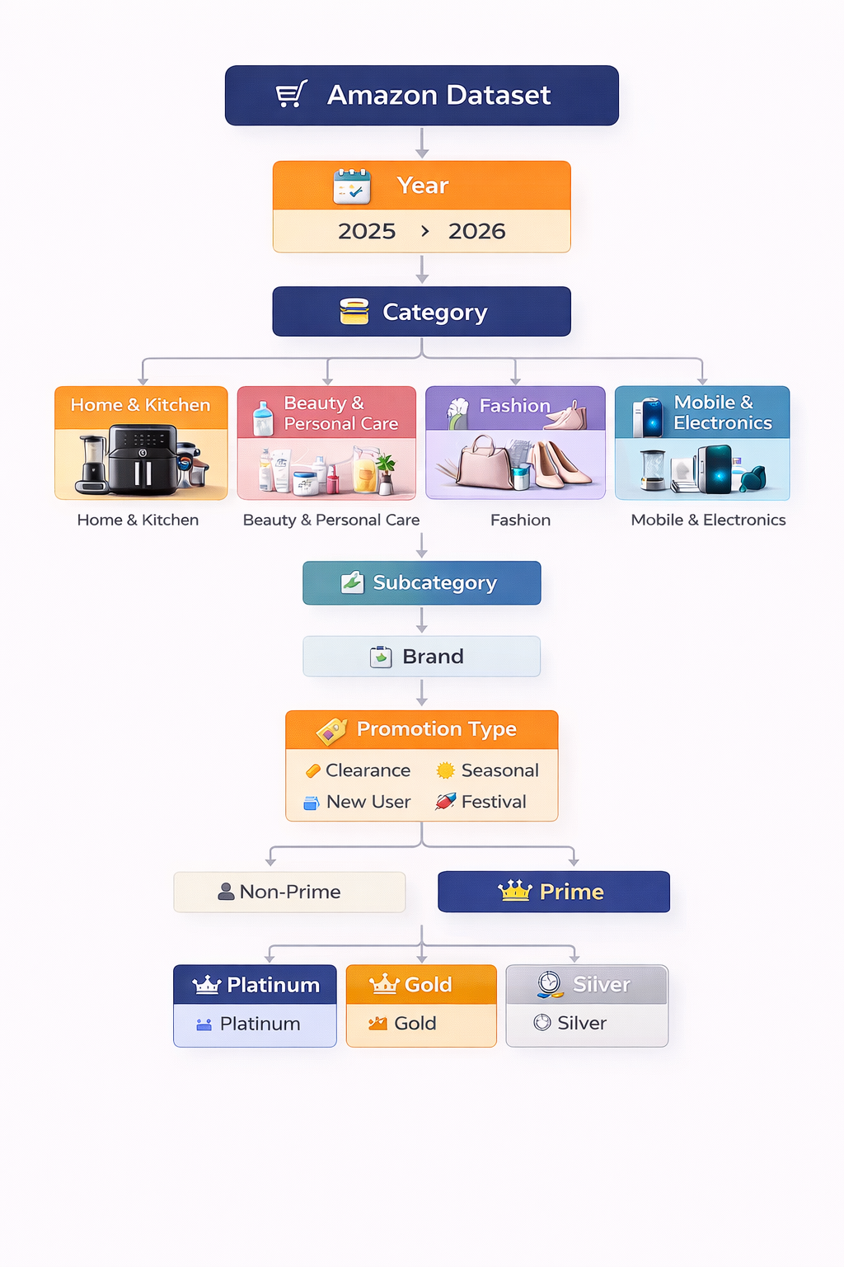
Dataset Overview
Time Period: 2025-2026
Categories: 4 product categories, 10+ subCategories,20+ brands
Orders : 5000

Slide 5
Data Pre-Processing
Removed unnecessary columns from the dataset and kept only relevant fields such as Order ID, Customer ID, Category, Subcategory, Brand, Promotion Type, Order Status, and Revenue.
Filtered the dataset to include only Delivered orders so that the analysis reflects actual completed sales and accurate revenue.
Checked and corrected data types for important columns like dates, revenue, and categorical fields to ensure consistency.
Handled missing or inconsistent values to improve data quality and reliability.
Created calculated measures in Power BI such as Total Revenue, Prime Revenue, Non-Prime Revenue, Total Orders, and Revenue per Customer to support further analysis in the dashboard.

Slide 6
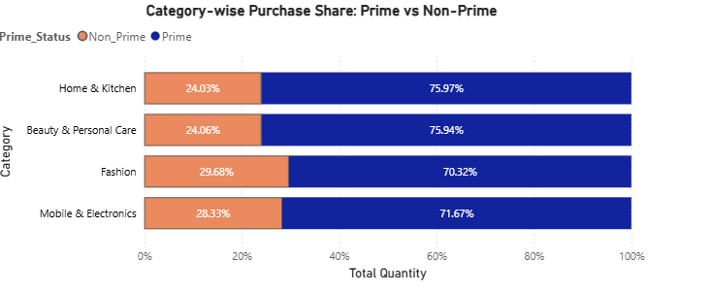
Category-wise Preference
● Prime customers contribute the majority of purchases in all categories, around 70–76%.
● Home & Kitchen (76%) and Beauty & Personal Care (76%) have the highest Prime purchase share.
● Non-Prime customers contribute around 24–30%, with the highest share in Fashion (30%).
● Offering Prime trials or discounts in Fashion and Electronics can help convert more Non-Prime customers.

Slide 7
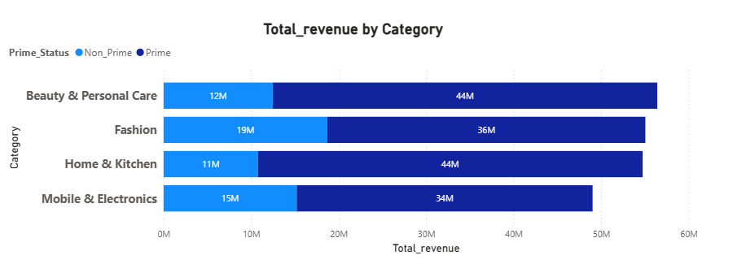
Revenue Contribution by Category
● Prime customers generate the highest revenue across all categories, contributing around 34M–44M, much higher than Non-Prime customers.
● Beauty & Personal Care and Home & Kitchen generate the highest revenue with 44M from Prime customers in each category.
● Non-Prime revenue is highest in Fashion (19M) compared to other categories.
● Promoting Prime membership benefits in Fashion and Electronics could increase overall revenue from Non-Prime customers.

Slide 8
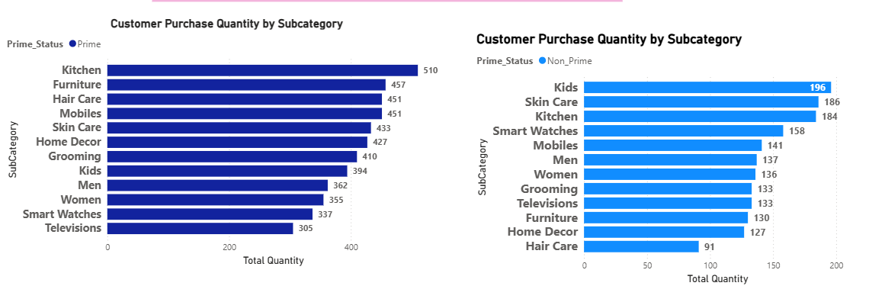
Customer Buying Trends by Subcategory
● Prime customers purchase more products overall, especially in Kitchen (510) and Furniture (457).
● Non-Prime customers buy the most in Kids (196) and Skin Care (186) categories.
● Sub Categories like Mobiles and Skin Care perform well for both Prime and Non-Prime customers.
● The business can promote Prime membership to Non-Prime buyers in Kids and Skin Care to increase sales.

Slide 9
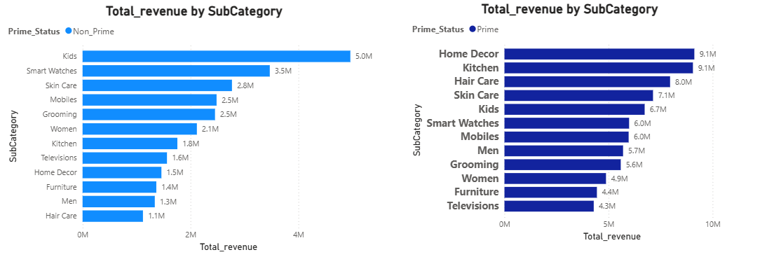
Subcategory Revenue Comparison: Prime vs Non-Prime
● Prime customers generate the highest revenue in Home Decor (9.1M) and Kitchen (9.1M), showing strong demand in home-related products.
● Non-Prime customers spend the most on Kids products (5.0M) and Smart Watches (3.5M) compared to other subcategories.
● Beauty-related items like Skin Care (7.1M Prime) and Hair Care (8.0M Prime) show strong revenue from Prime customers.
● The company can target Non-Prime customers in Kids and Smart Watches with Prime membership offers to increase conversions and revenue

Slide 10
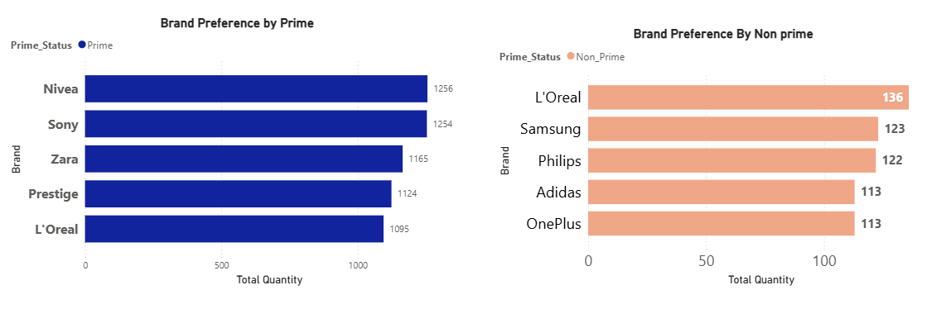
Top Brand Purchases by Prime and Non-Prime Customers
● Prime customers purchase more from Nivea (1256) and Sony (1254), showing strong demand for these brands among Prime members.
● Brands like Prestige (1124) and Philips (1058) are also highly preferred by Prime customers.
● Non-Prime customers show higher interest in L'Oréal (136) and Samsung (123) compared to other brands.
● Offering Prime deals on popular Non-Prime brands like L'Oréal and Samsung could encourage customers to upgrade to Prime.

Slide 11
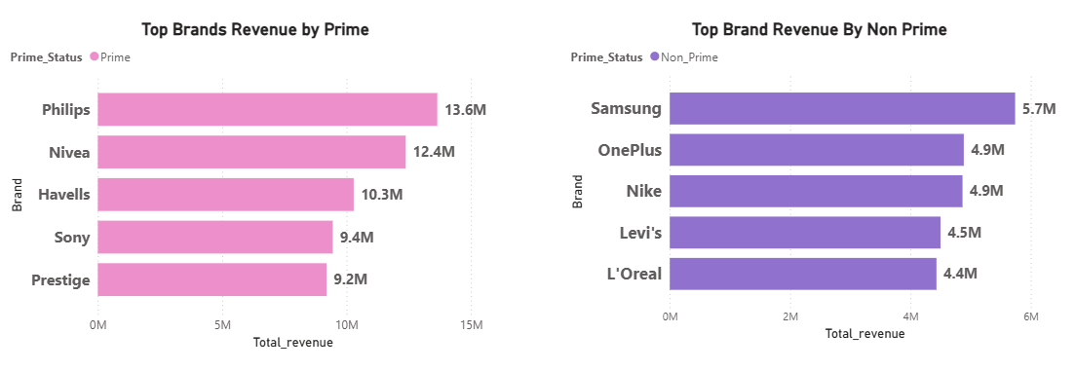
Prime vs Non-Prime Revenue by Brand
● Prime customers generate the highest revenue from Philips (13.6M) and Nivea (12.4M), showing strong loyalty to these brands.
● Other brands like Havells (10.3M) and Sony (9.4M) also perform well among Prime customers.
● Non-Prime customers generate the most revenue from Samsung (5.7M) and OnePlus (4.9M).
● Offering Prime-exclusive deals on Samsung and OnePlus could encourage Non-Prime customers to upgrade to Prime.

Slide 12
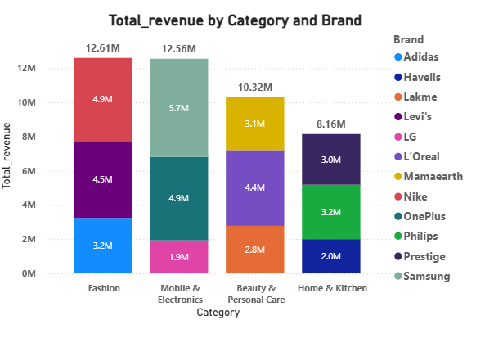
Revenue Contribution by Category and Top Brands
Fashion and Mobile & Electronics generate the highest revenue, around 12.6M each.
In Fashion, brands like Nike and Levi's contribute the most revenue.
In Mobile & Electronics, brands such as Samsung and OnePlus drive most of the sales.
Beauty & Personal Care generates steady revenue from brands like L'Oréal and Mamaearth.
Home & Kitchen also shows consistent demand with brands like Philips and Prestige.

Slide 13
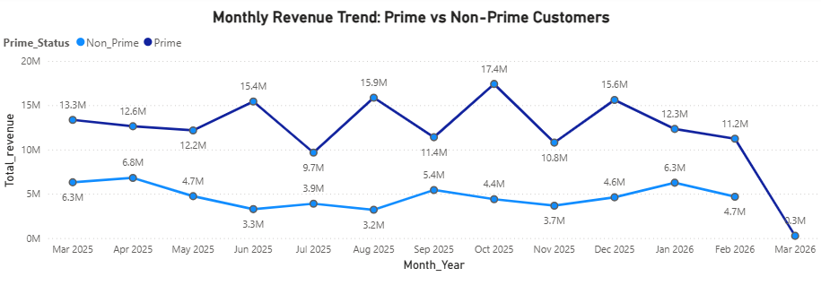
Monthly Revenue Trend: Prime vs Non-Prime Customers
● Prime customers consistently generate higher revenue each month, peaking at 17.4M in Oct 2025.
● Non-Prime revenue remains lower, with the highest value 6.8M in Apr 2025 and 6.3M in Jan 2026.
● Revenue increases during mid-year and festive months (Jul, Sep, Oct, Dec,Jan), showing seasonal demand.
● Running Prime membership campaigns during high-demand months could convert more Non-Prime customers to Prime.

Slide 14
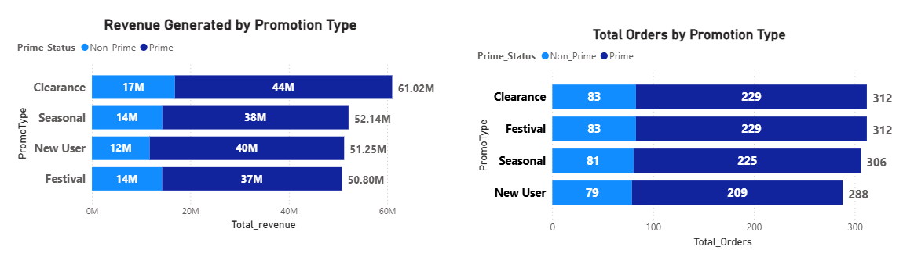
Revenue and Orders by Promotion Type
● Clearance promotions generate the highest revenue (61M) and orders (312), mainly from Prime customers.
● Seasonal and New User promotions also contribute strong revenue, around 51M–52M.
● Non-Prime customers participate in all promotions but generate lower revenue than Prime customers.
● Offering Prime-exclusive discounts during clearance and festival promotions can help convert more Non-Prime customers to Prime.

Slide 15
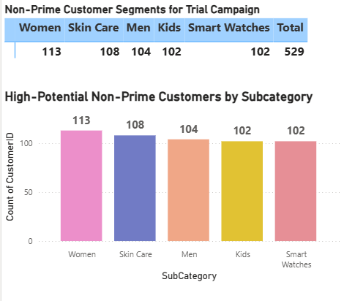
Prime Trial Target Customer Count
● A total of 529 active Non-Prime customers were identified as potential targets for a Prime trial.
● The highest number of customers are in Women (113) and Skin Care (108) categories.
● Categories like Men (104), Kids (102), and Smart Watches (102) also show strong Non-Prime customer activity.
● Offering category-based Prime trial benefits or discounts can encourage these active customers to upgrade to Prime

Slide 16
Summary:
● Prime customers contribute the majority of revenue and purchase quantity across most categories, brands, and promotions.
● Categories like Fashion, Mobile & Electronics, and Beauty & Personal Care generate strong revenue and customer engagement.
● Non-Prime customers are active in subcategories such as Women, Skin Care, Men, Kids, and Smart Watches, with 529 potential customers identified for Prime trial targeting.
● By offering Prime-exclusive discounts, seasonal promotions, and trial memberships, the business can convert active Non-Prime customers into Prime members and increase overall revenue
.

Slide 17
Strategic Recommendations:
Increase Prime Conversion: Target high-value Non-Prime customers with exclusive Prime offers, free trials, and personalized promotions.
Category Focus: Promote high-demand categories and subcategories that attract more Non-Prime customers to increase engagement.
Brand Collaboration: Partner with top-performing brands to provide exclusive deals and bundles for Prime members.
Optimized Discount Strategy: Use targeted discounts and promotional campaigns to encourage frequent purchases and Prime upgrades.
Customer Personalization: Use purchase history and behavior data to deliver personalized product recommendations and marketing offers.
Regional & Customer Segmentation: Customize marketing strategies based on region, customer type, and buying patterns to improve conversion rates.
Improve Customer Loyalty: Strengthen loyalty programs and enhance customer experience to increase retention and long-term revenue.

Slide 18
Next Steps & Action Plan
Immediate (0–30 days): Launch Prime trial offers and targeted promotions for high-value Non-Prime customers
Short-term (1–3 months): Run category-focused marketing campaigns and promote top-performing brands
Medium-term (3–6 months): Improve personalized recommendations and strengthen promotional strategies
Long-term (6–12 months): Enhance customer loyalty programs and expand Prime membership benefits
Monitoring: Track monthly KPIs such as revenue, orders, and Prime conversion rate
Review: Conduct quarterly analysis to evaluate performance and refine strategies

Slide 19


